Slide 1
Dimensionality Reduction
Muhammad Umar
UIAI Lab

Slide 2
Outlines
The Curse of Dimensionality
Main Approaches for Dimensionality Reduction
Projection
Manifold Learning
PCA
Kernal PCA
LLE

Slide 3
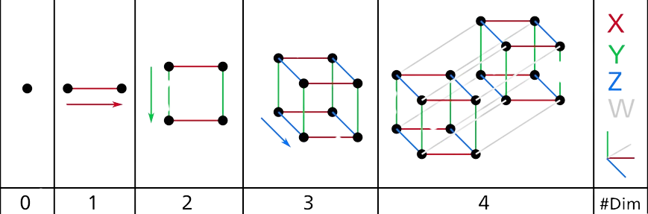
The Curse of Dimensionality
We live in three dimensions that our intuition fails us when we try to imagine a high-dimensional space.
Figure: Dimensional Features
Even a basic 4D hypercube is incredibly hard to picture.

Slide 4
Main Approaches for Dimensionality Reduction
There are two main approaches to reduce dimensionality
  Projection
  Manifold Learning

Slide 5
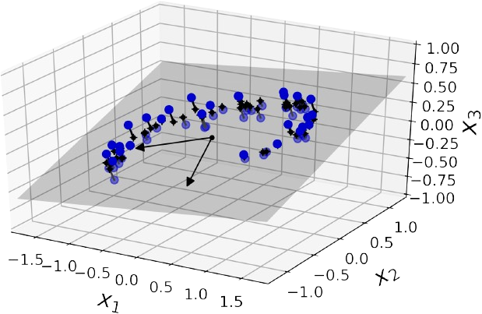
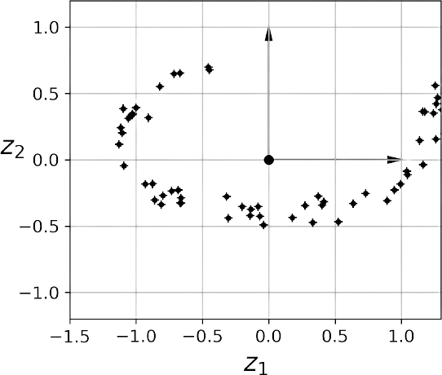
Projection
Project every
training instance
You can see a 3D dataset represented by the circles.
The new 2D dataset after projection
Using Projection technique, we have just reduced the dataset’s dimensionality from 3D to 2D!!

Slide 6
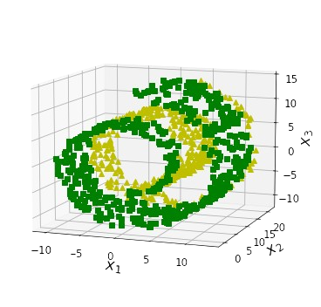
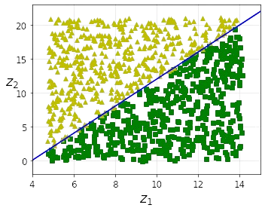
Manifold Learning
  A d-dimensional manifold is a part of an n-dimensional space (where d<n) that locally resembles a d-dimensional hyperplane.
  2D manifold is a 2D shape that can be bent and twisted in a higher dimensional space.
Split into two classes.
Manifold the data
The decision boundary is a simple straight line.

Slide 7
Principle Component Analysis (PCA)
PCA is the most popular dimensionality reduction algorithm.
PCA has two steps:
  It identifies the hyperplane that lies closest to the data
  It projects the data onto it.
Preserving the variance.
Principal Components
Projecting down to d-dimensions

Slide 8
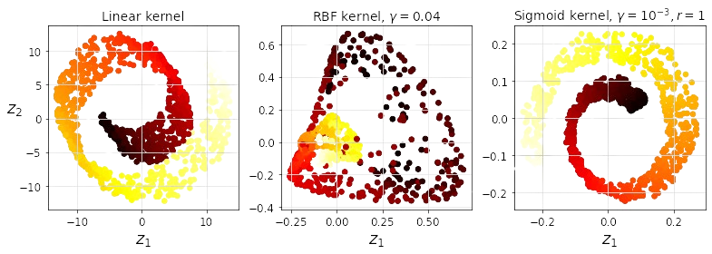
Kernal PCA (kPCA)
Making kernel trick possible to perform complex non-linear projections for dimensionality reduction.
Kernel Trick A mathematical technique that implicitly maps instances into a very high-dimensional space.
It is often good at preserving clusters of instances after projection.
Figure: kPCA with various kernels

Slide 9
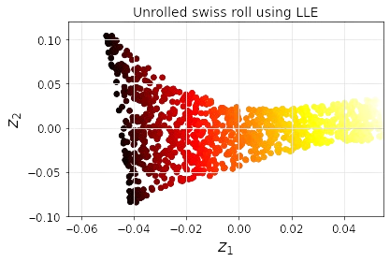
Locally Linear Embedding (LLE)
LLE is powerful non-linear dimensionality reduction method.
Does not rely on projection.
Measuring how each instance linearly relates to its closest neighbors.
Figure: LLE Technique

Slide 10
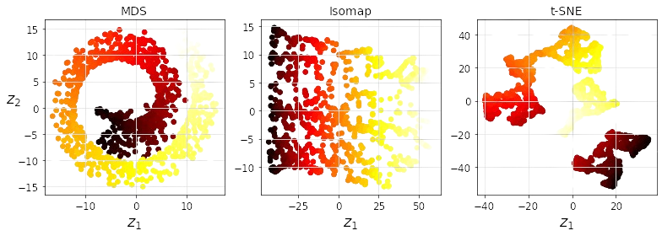
Other Dimensionality Reduction Techniques
Random Projections
  Random Projections, depend on numbers of instances and targeted dimensionality.
Isomap
  Creates a graph by connecting each instance to its nearest neighbours.
T-Distributed Stochastic Neighbor Embedding(t-SNE)
  Keep similar instance close and dissimilar instance apart.
Linear Discriminant Analysis(LDA)
  Classification, Keep classes as far apart as possible.
Figure: Various Techniques

Slide 11
Thank You

